Slide 1
JD & CV Matching System

Slide 2
Outline
Part I ： Build skill graph
  Recognize skills from JD & CV
  Extract Hierarchical relation of skills
Part II ：JD & CV recommendation
  Distributed Representations of JD & CV
  JD&CV Fast Matching
Part III ：Find the Gap between JD & CV
  Extract information from JD & CV
  Compare skill set in JD and CV , find the Gap

Slide 3

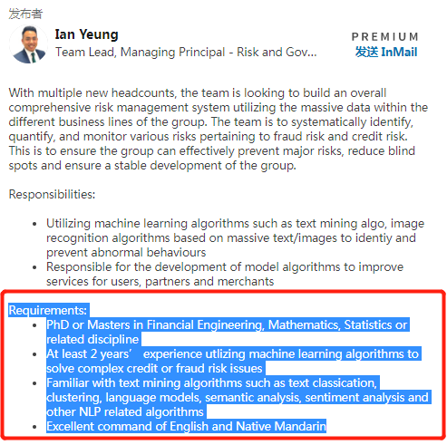
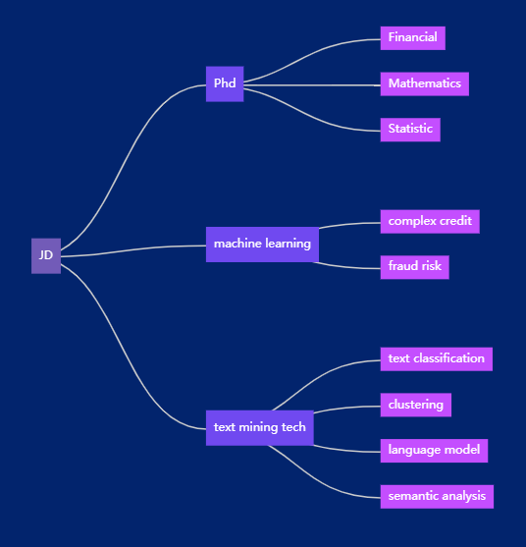
Part I: Build skill graph

Slide 4
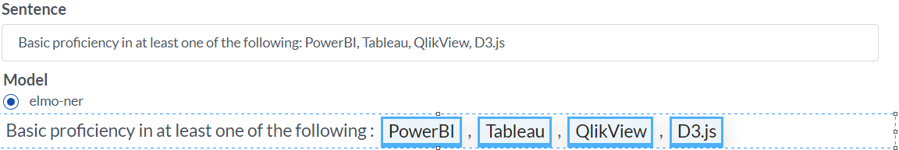
recognize skill words
  skill may contains several words, sometimes abbreviation
    expertise in Software development involving cloud computing platforms like Amazon Web Services (AWS)
  new skill will come out
    Experience in installing, configuring, managing MYSQL, SQL Server, PostgreSQL, Oracle, MongoDB & Cassandra.
  recognize skill word need domain knowledge
    Experience in monitoring tools like Nagios, Splunk, CloudWatch, ELK Stack, Dynatrace and App Dynamics.

Slide 5

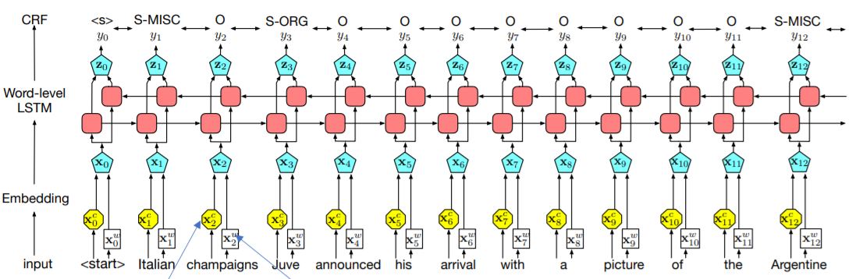
recognize skill words by sequence labeling model
sequence labeling model is very popular in find entity in biomedical document.

Slide 6
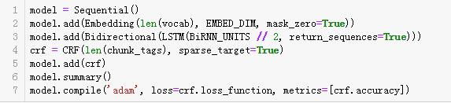
model training
Sample:

Slide 7
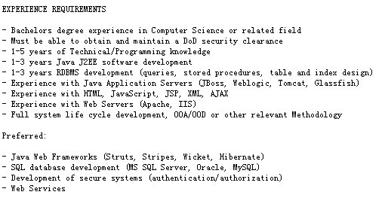
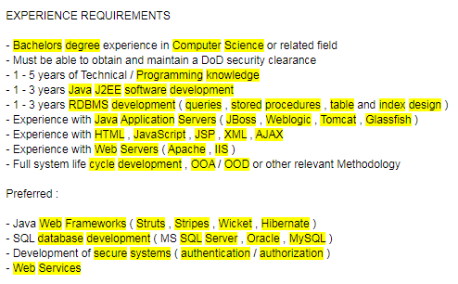
output the NER result
Input： output:

Slide 8
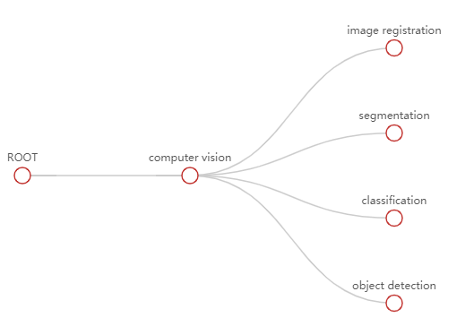
extract hierarchical relationship of skills
We need to extract the hierarchical relationship of skills
strong knowledge in computer vision, including image registration, segmentation, classification, object detection.

Slide 9
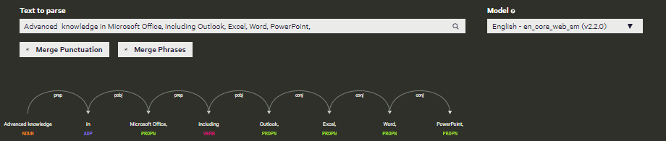
relation extraction by Dependency Parsing
Put the sentence to dependency parser, we can get grammatical structure and the relationships between words

Slide 10
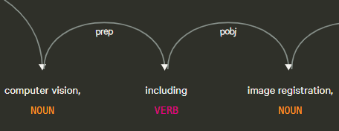
Usually,
the relation we want are in particular grammatical structure.
Image registration is an object of a preposition (pobj) link to Including (prep) link to computer vision.
And segmentation, classification, detection is conjunct(conj) link to Image registration
So we can get:
computer vision -> image registration
and
computer vision -> segmentation
computer vision -> classification
computer vision -> object detection

Slide 11
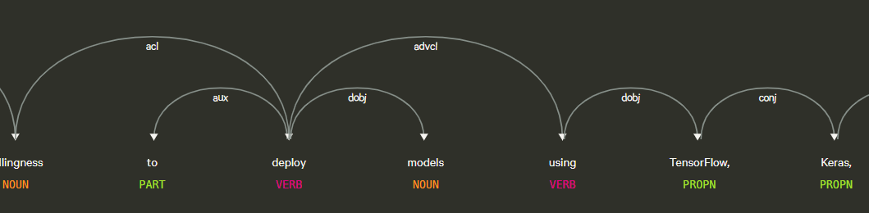
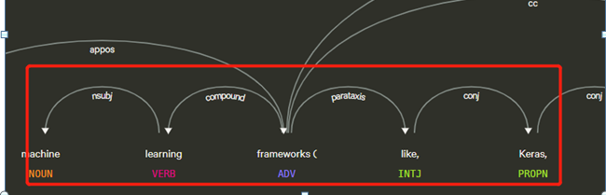
First, We try to find the all the grammatical structures we want.
Then, when we recognize a skill word , retrieval it in the grammar tree. Try to find if is it in the grammatical structure we want.
If yes, output the tuple:
  Machine learning framework => keras

Slide 12
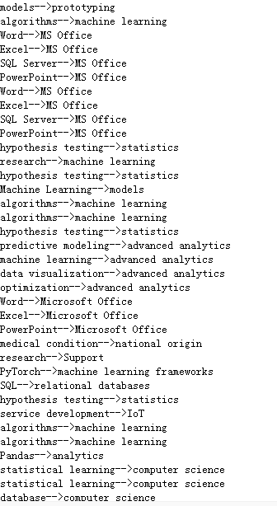
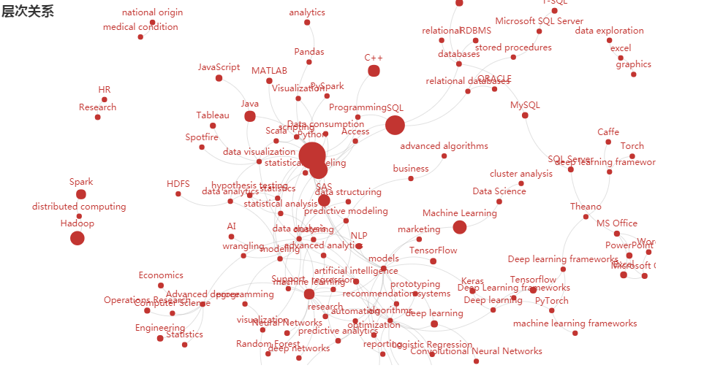
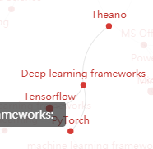
Visualization

Slide 13
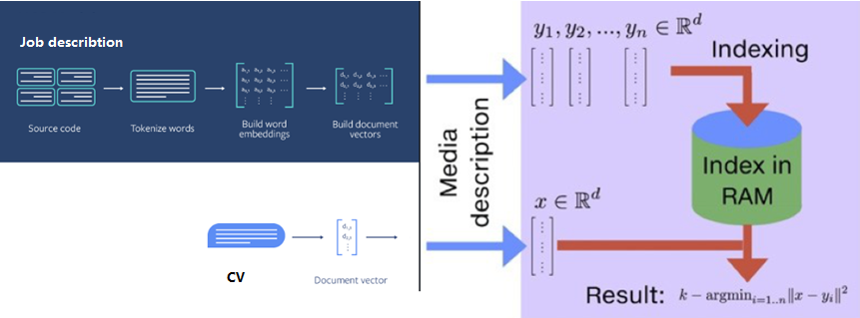
Part II: JD & CV recommendation
represent JD& CV as vectors, and put into vector space. Then search on the vector space ,we can find the best match.

Slide 14
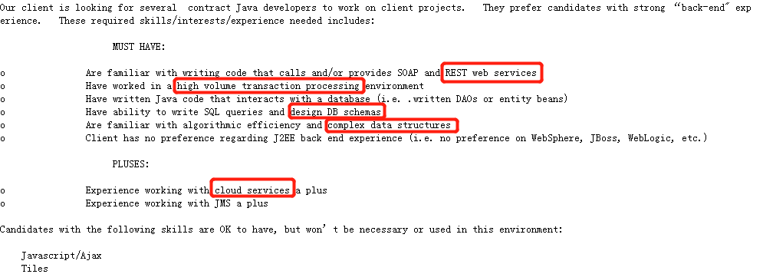
Distributed Representations of JD&CV
Why choice textCNN for embeding, but not【RNN, LSTM…】
Generally：
JD&CV contains short sentences ,don’t has long dependency
The information we want extract are locally, Suit for CNN

Slide 15
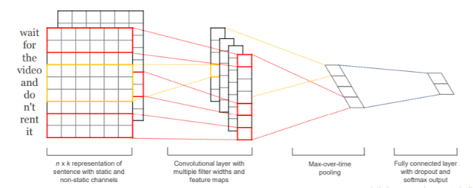
textCNN for document embeding
The filters of the textCNN neural network are 1-D slide windows，it will slide over the sentence and extract the local information

Slide 16
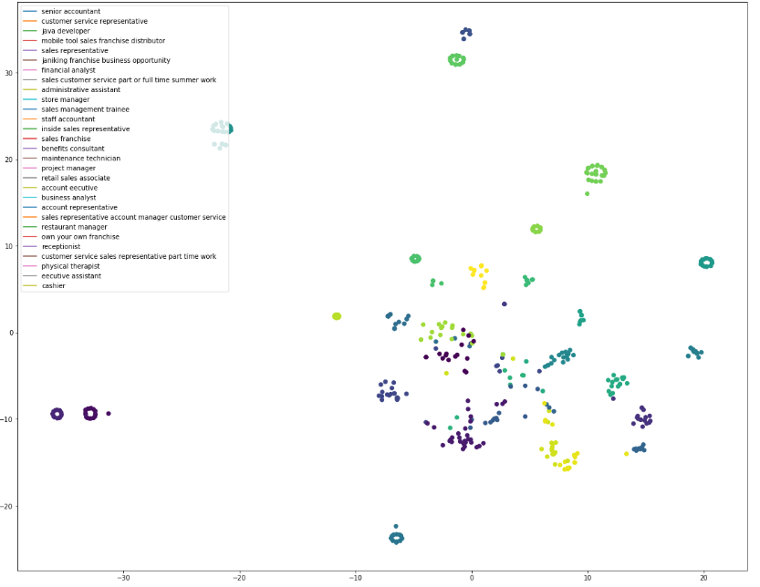
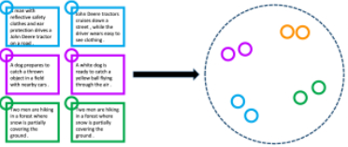
JD&CV vector space
We use the Job requirement and Job title to train textCNN, and extract the middle layer of model as vector representation.

Slide 17
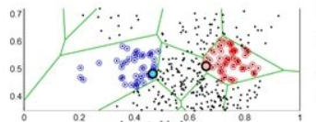
JD&CV Fast Matching
For fast matching ,we split vector space to small cells, similar vectors are in the same cell. So when we get a query , we do not need to go over the total vector space.

Slide 18
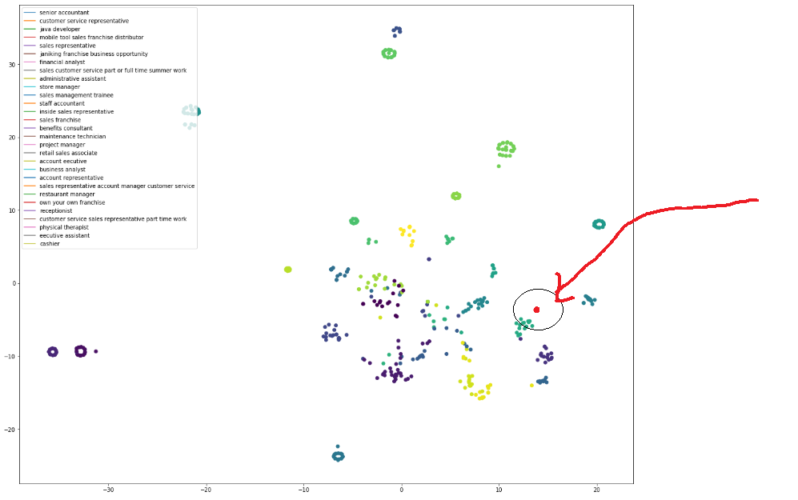
When get a resume, we represent it to vector by textCNN，then search in the vector space ,then return the most simmilar JD.

Slide 19
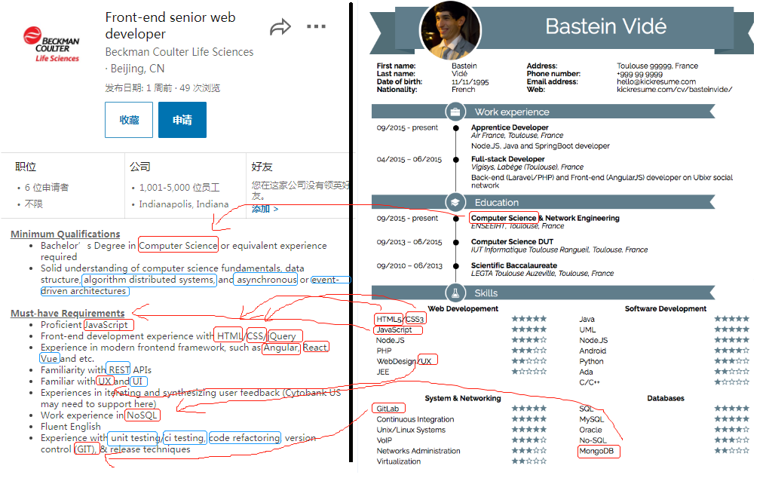
Part III: Find the Gap between JD&CV
Basic idea:
We see JD as template, try to use the skills in CV to fill it.
The slot cannot be fill is the Gap【blue】

Slide 20
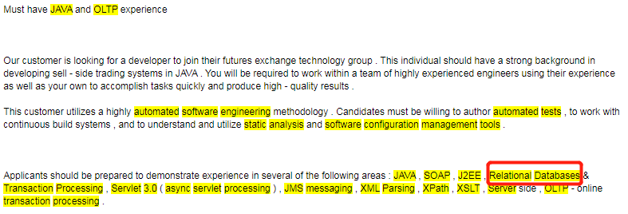
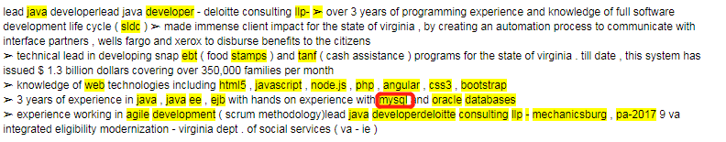
Problem to solve
In some cases：JD&CV say skills in different ways.
The skill JD required is relation database
The skill candidate have is mysql

Slide 21
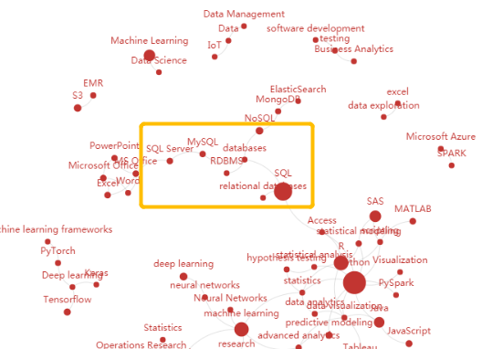
Expand skills in skill graph
Base on the skill graph we build before, we know that
MySQL is belong to relational database
In that way，we can compare skill set in JD&CV，even them mentions in different ways

Slide 22
Thank you

